Slide 1

Team Members
Daniel Hodek
Nate Lemke
Adam Doquiatan
Justin Kwok

Slide 2
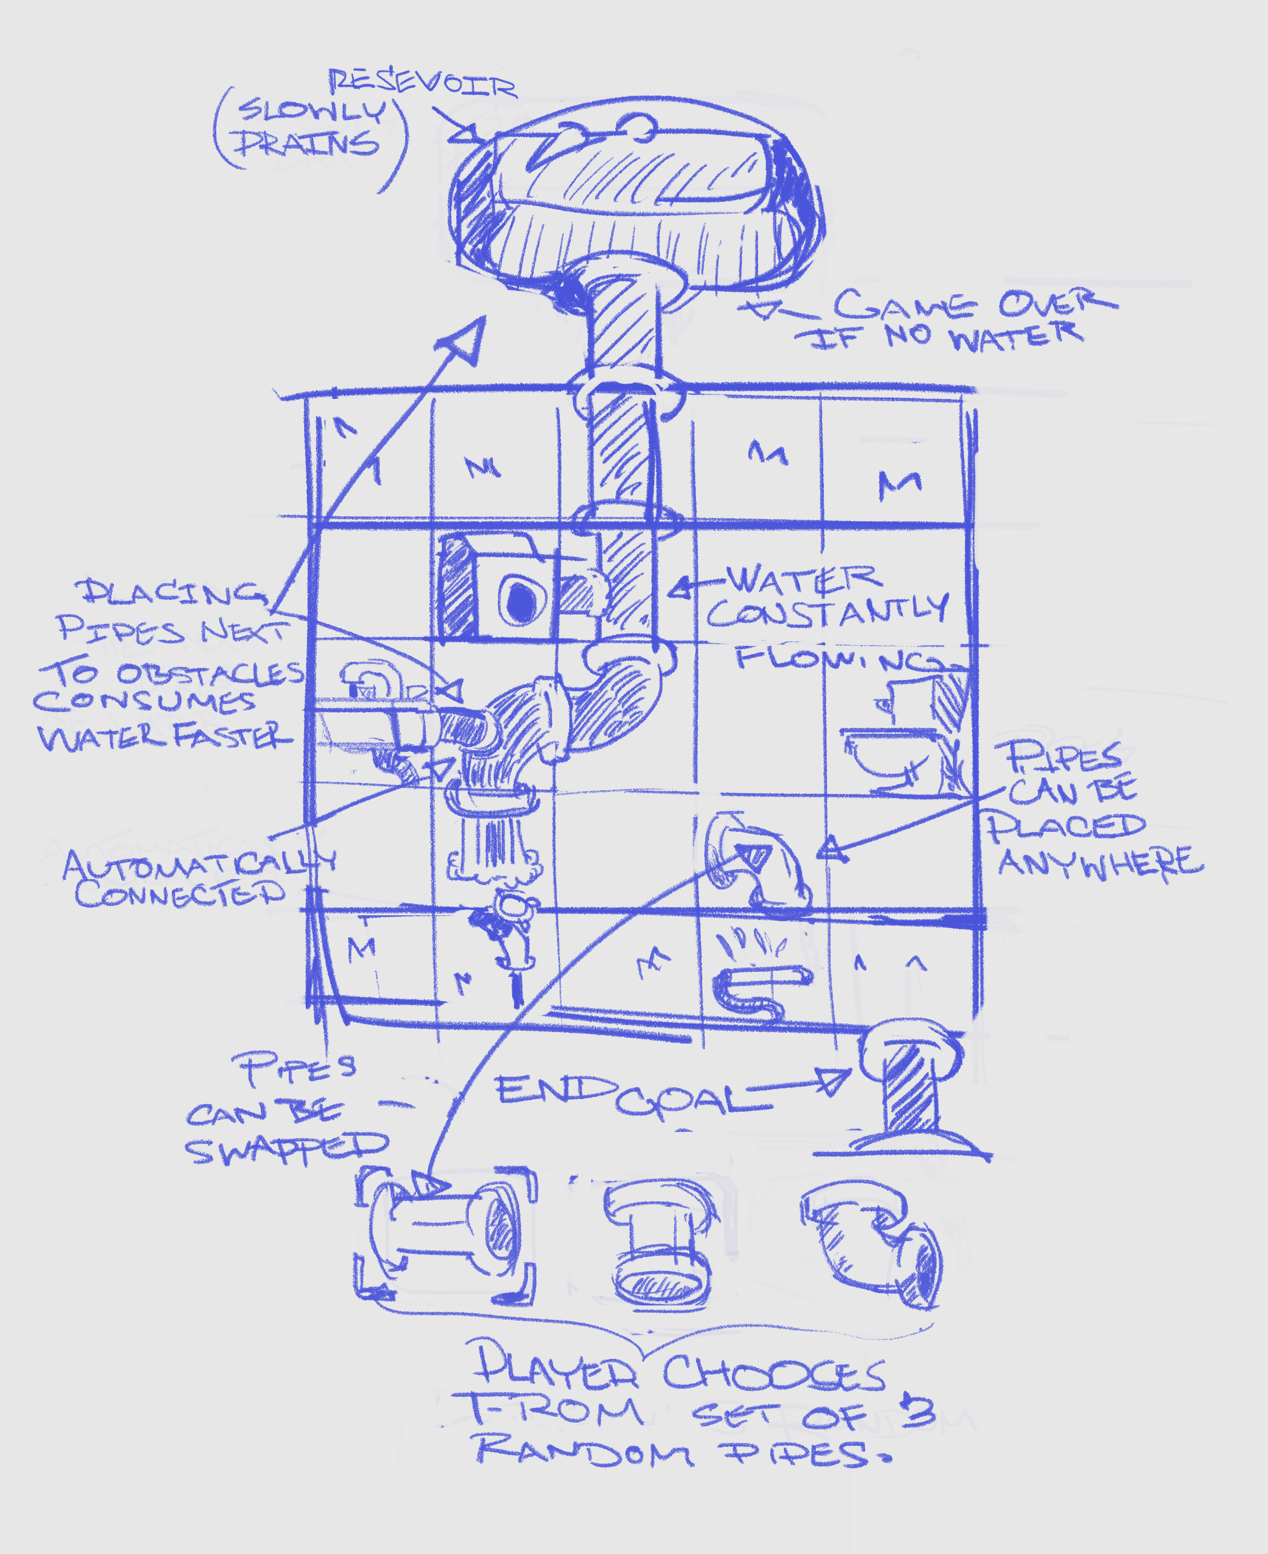
What does our app do?
A Puzzle Game: Connect pipes and conserve water.
Goal: Transfer water from one area to another.
Avoid: Obstacles that waste water (sprinklers, leaks, faucets, etc.)
Watch out!: Limited water supply.
Learn: Water saving tips/statistics between levels.
Consider: Quantifies water wastage at the end of each level.

Slide 3
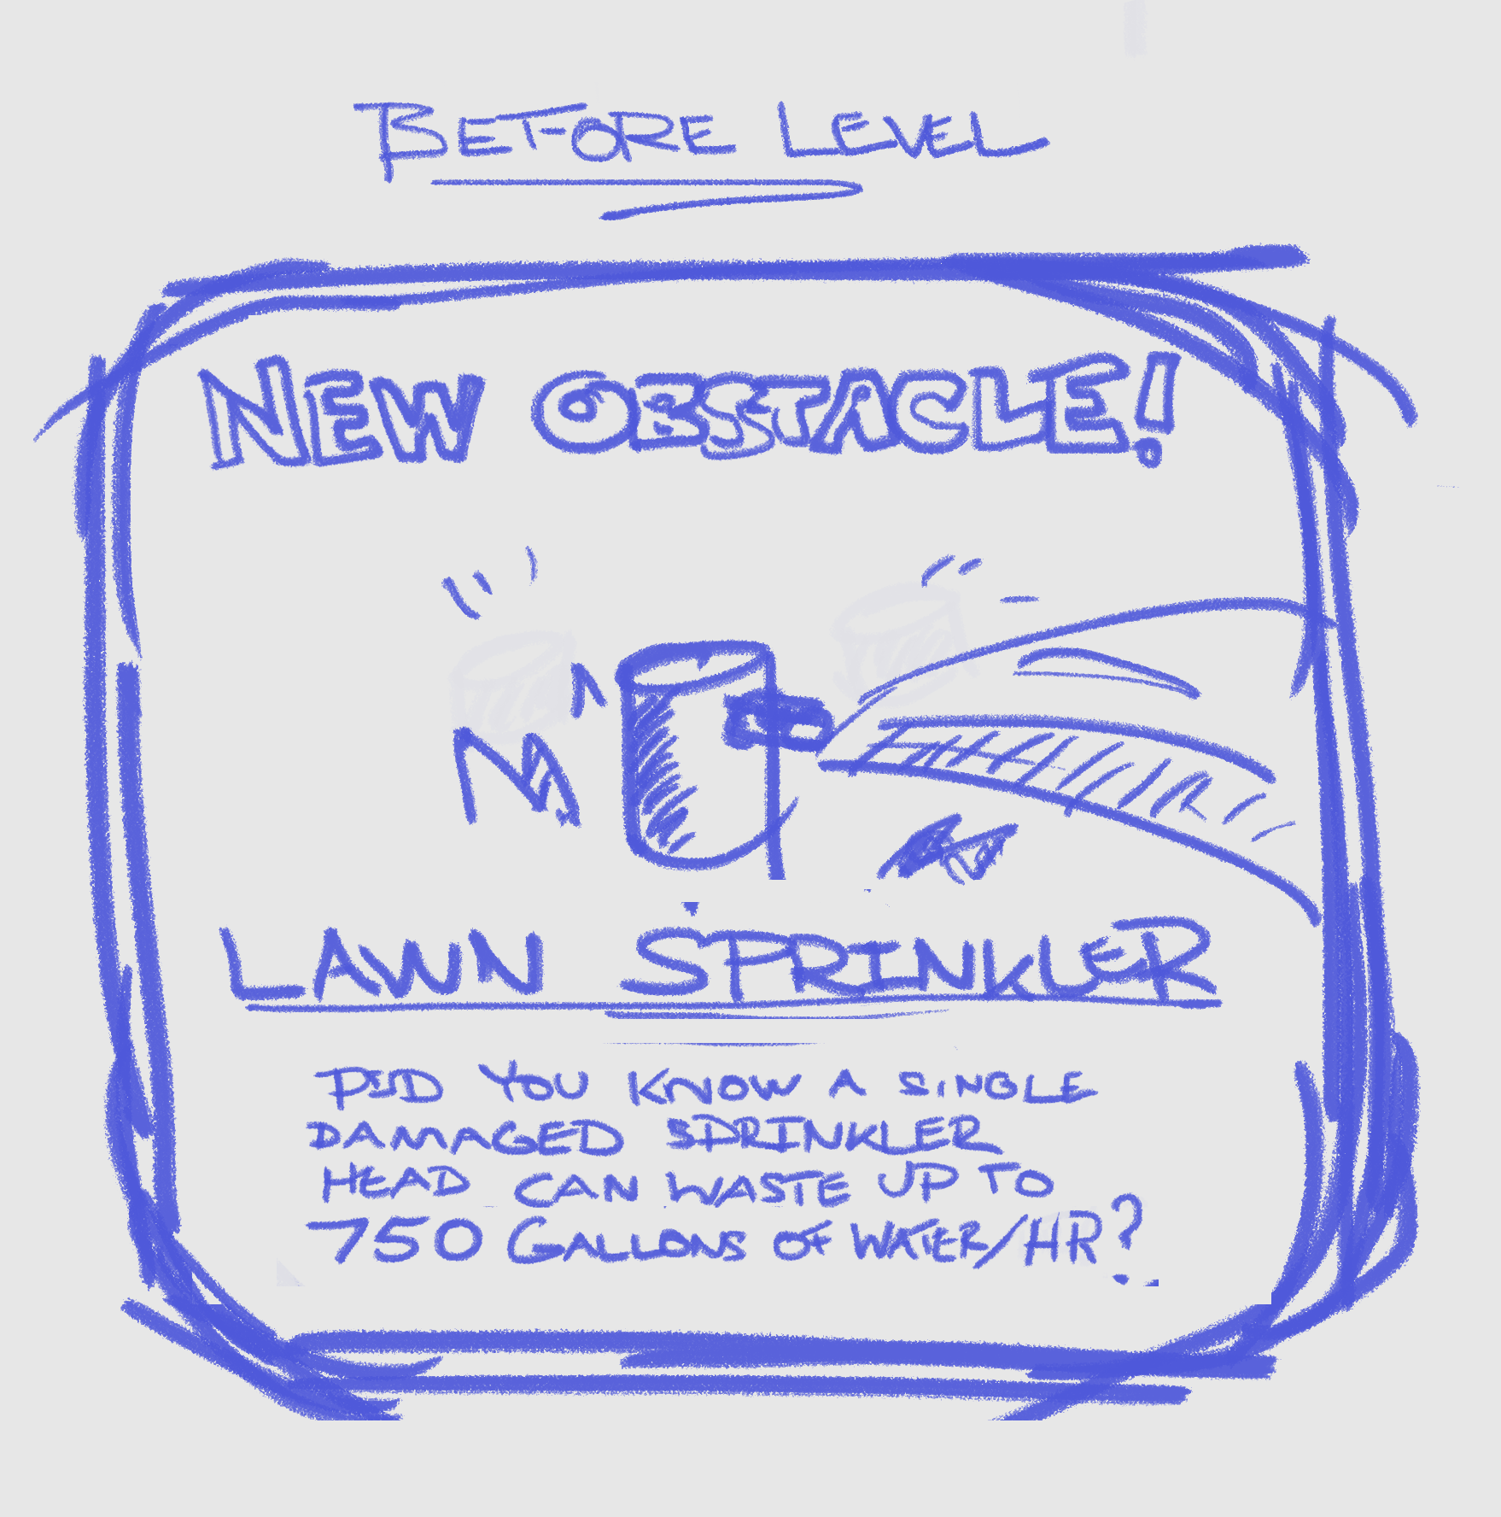
What problem does it solve?
Answers key questions:
How much water is wasted every day?
How can we reduce it?
Educates and informs about the water system via:
Facts
Tips
Theme
Narrative
Inspires players to make water conscious decisions.

Slide 4
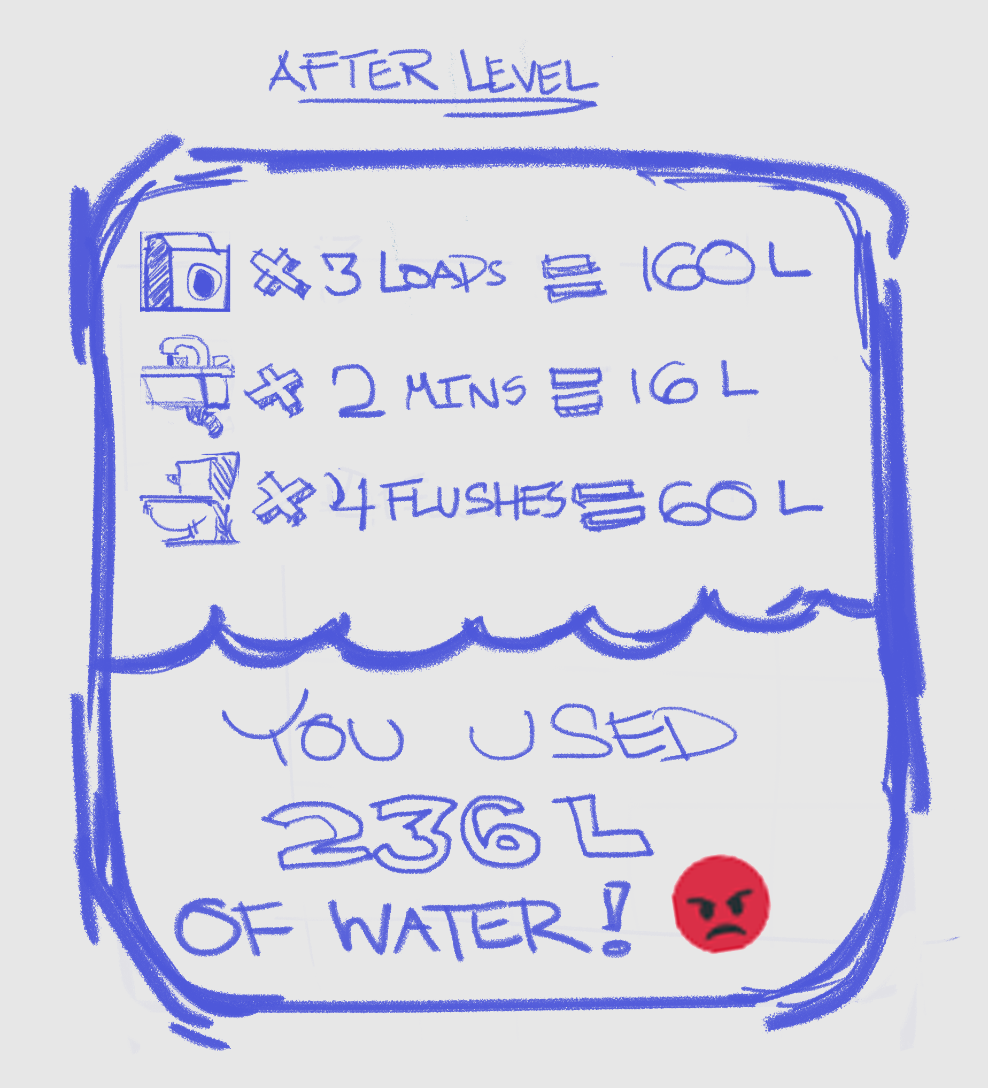
Who is the target market?
Residential Occupants:
Homeowners
Kids
Students
People who prefer to learn through games.

Slide 5
How is it unique?
Educates and informs about water conservation.
Provides facts and tips on how to waste less water.
Relatable setting.
Real water usage statistics.
Environmentally relevant narrative.

Slide 6
Minimum Viable Product
One level
One obstacle type
Grid-based level layout
Pipes (straight and elbow)
Pipe selection box which refills when pipes used
Finger-tap functionality
Minimalist art style
Water Level (Timer/Health)
Main Menu Screen
Victory Screen
Lose Screen

Slide 7
Member Responsibilities
Daniel: Art Assets and Game Design
Nate: Database and PHP
Adam: Presentations and Writing
Justin: Project Management, Version Control, and Testing
Everyone: Game Coding

Slide 8
Technologies
Phaser Framework
JavaScript
HTML and CSS
PHP and MySQL
Chrome
Photoshop
Visual Studio Code
GitHub
XAMPP
Discord

